Slide 1


WIA1006 MACHINE LEARNING
SEMESTER 2 SESSION 2025/2026
GROUP 3
TYING THE (DATA) KNOT: LOVE, LIFE & LIKES
Predicting Relationship Connection Outcomes Using Machine Learning

Slide 2

PROJECT OVERVIEW
THIS PROJECT AIMS TO PREDICT WHETHER A DATING APP INTERACTION WILL LEAD TO A SUCCESSFUL CONNECTION.
Using a dataset of 50,000 dating profiles, we developed an end-to-end machine learning pipeline involving:
Data preprocessing
Feature engineering
Feature selection
Model training
Explainable AI
Causal inference

Slide 3

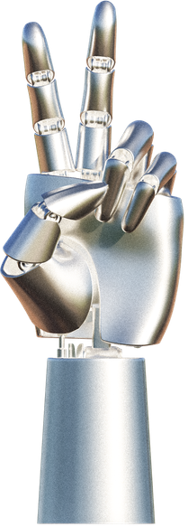
PROBLEM STATEMENT
Dating platforms rely heavily on recommendation systems.
However:
User behaviour is highly complex
Many variables influence relationships
Correlation does not imply causation
Key Question:
Can machine learning accurately predict successful relationship outcomes using behavioural and demographic information?

Slide 4
DATASET OVERVIEW
Dataset Source:
Kaggle Dating App Behavior Dataset
Dataset Characteristics:
50,000 records
25 raw features
Demographic information
Behavioural patterns
Match outcomes
Examples of Features:
Age
Gender
Education
Income
Likes received
Mutual matches
Swipe ratio
Message count
Demographic
Behavioural
Match Outcome
Engagement

Slide 5
TARGET ENGINEERING
10 Classes
Original Dataset:
10 relationship outcome categories
Examples:
Mutual Match
Long-Term Relationship
Ghosted
Catfished
No Response
Converted into Binary Classification:
Positive Outcome → Successful Connection
Negative Outcome → Unsuccessful Connection
Binarization
Connection = 1
No Connection = 0

Slide 6
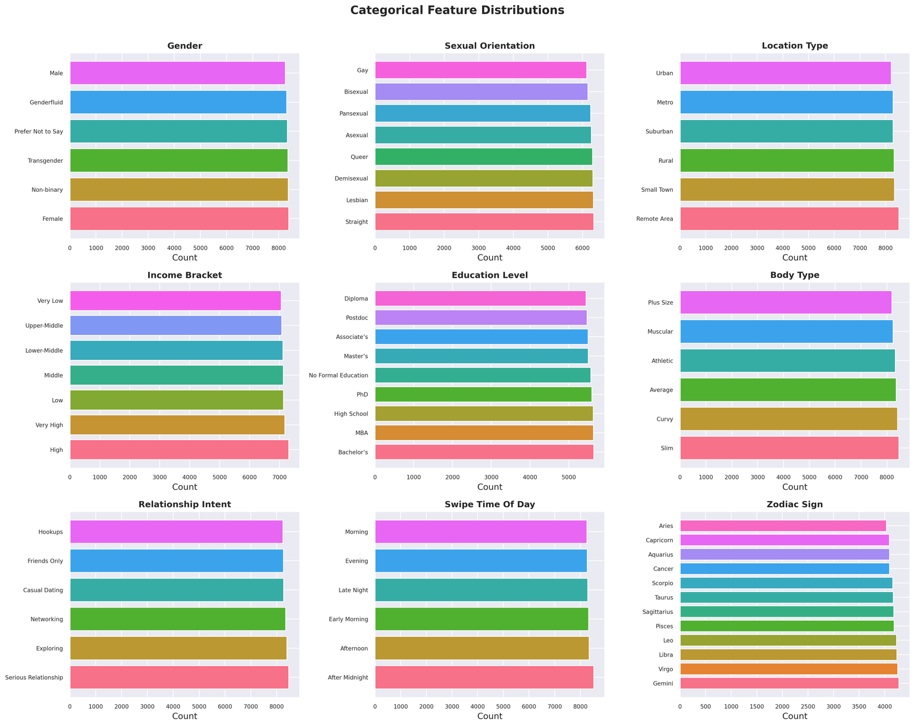
EXPLORATORY DATA ANALYSIS (EDA)
Initial EDA focused on:
Missing values
Duplicate records
Target distribution
Feature distributions
Correlation analysis
Findings:
No missing values
No duplicate records
Balanced synthetic dataset

Slide 7
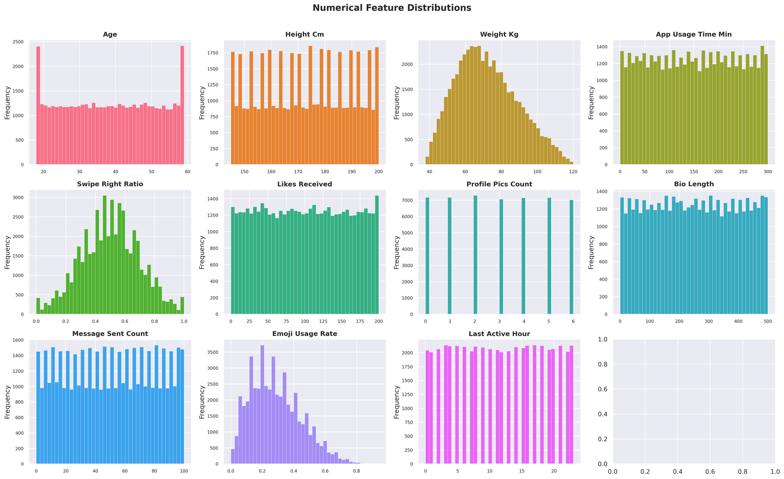
NUMERICAL FEATURE DISTRIBUTIONS
Observations:
Age follows normal distribution
Height approximately symmetric
Activity metrics highly skewed
Likes and messages contain heavy tails
Implication:
Standard scaling unsuitable.
RobustScaler selected.

Slide 8
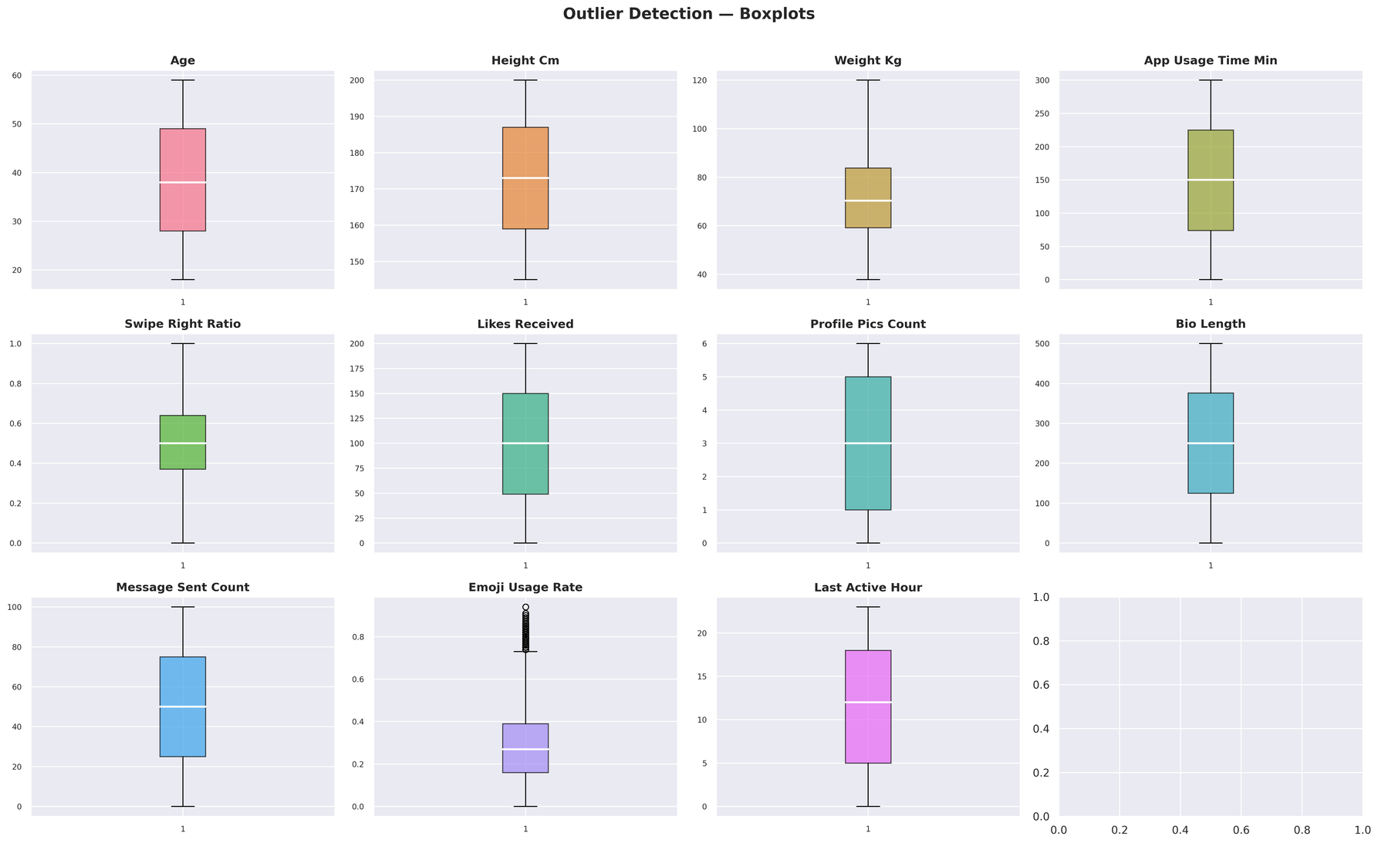
OUTLIER ANALYSIS
Power users produce extreme values in:
Likes received
Mutual matches
Messages sent
These outliers may distort model behaviour.
Solution:
Isolation Forest OOD Detection

Slide 9
DATA PREPROCESSING PIPELINE
SmartArt pipeline:
Raw Data
Applied:
Target Binarization
Ordinal Encoding
One-Hot Encoding
Multi-Hot Encoding
Robust Scaling
Generated:
67 Machine Learning Features
Encoding
Scaling
Feature Engineering
ML Features

Slide 10
FEATURE ENGINEERING
Created behavioural interaction features:
Popularity Density
Likes Received / Usage Duration
Bio Message Interaction
Bio Length × Message Count
Selective Emoji Swiper
Emoji Usage × Swipe Behaviour
Purpose:
Capture hidden behavioural patterns.

Slide 11
OUT-OF-DISTRIBUTION DETECTION
User Profile
Isolation Forest was deployed before classification.
Purpose:
Detect abnormal profiles
Reject anomalous inputs
Improve reliability
Profiles exceeding anomaly threshold are excluded from prediction.
Isolation Forest
Normal → Model
Anomaly → Reject

Slide 12
FEATURE SELECTION STRATEGY
Three complementary methods used:
ANOVA F-Test
Mutual Information
Boruta
Final Features:
67 selected variables
Benefits:
Reduce noise
Improve efficiency
Retain useful information

Slide 13
MODELS EVALUATED
14 MODELS TESTED
Traditional:
Logistic Regression
KNN
Decision Tree
Random Forest
Ensemble:
XGBoost
LightGBM
CatBoost
Deep Learning:
FT-Transformer
SAINT
NODE
Advanced:
TabPFN
SVM Bagging

Slide 14
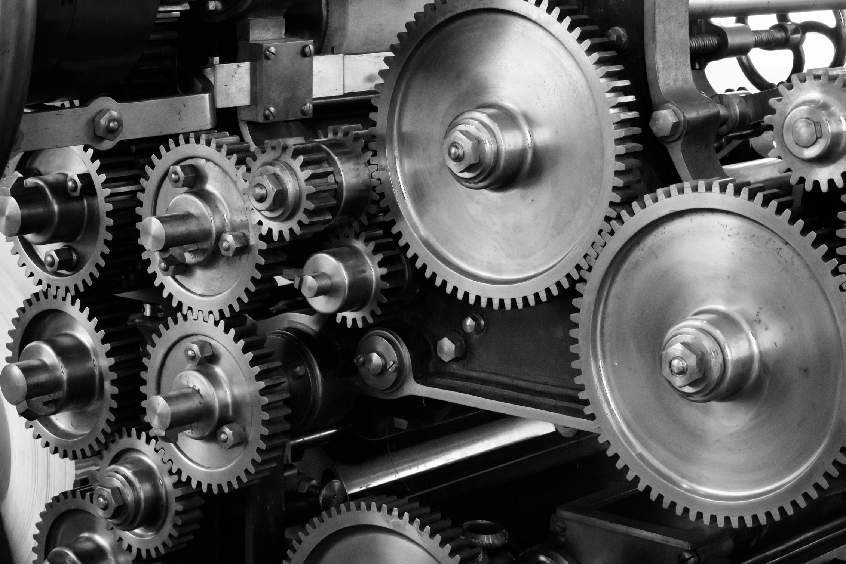
TRAINING STRATEGY
Training Process:
80/20 Train-Test Split
Stratified Sampling
SMOTE Balancing
RandomizedSearchCV
10-fold Cross Validation
GOAL:
ObTAIN FAIR AND ROBUST EVALUATION.

Slide 15
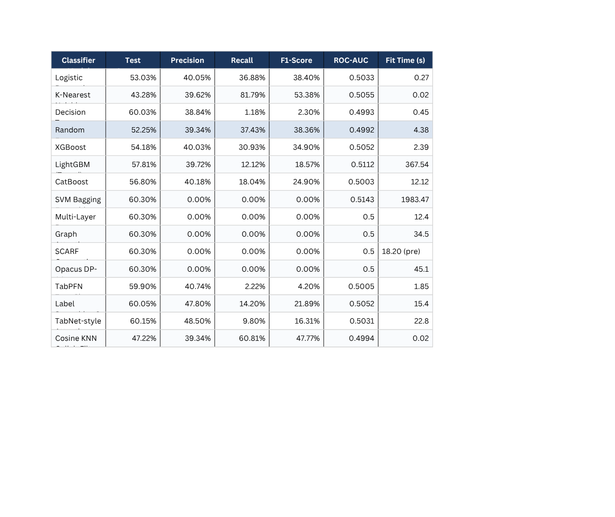
PERFORMANCE COMPARISON
Comparison based on:
Accuracy
Precision
Recall
F1 Score
ROC-AUC

Slide 16
CHAMPION MODEL : LIGHTGBM
Selected because:
Strong ROC-AUC performance
Fast training
Native SHAP support
Handles non-linear interactions
Performance:
Accuracy: 57.81%
ROC-AUC: 0.5112

Slide 17
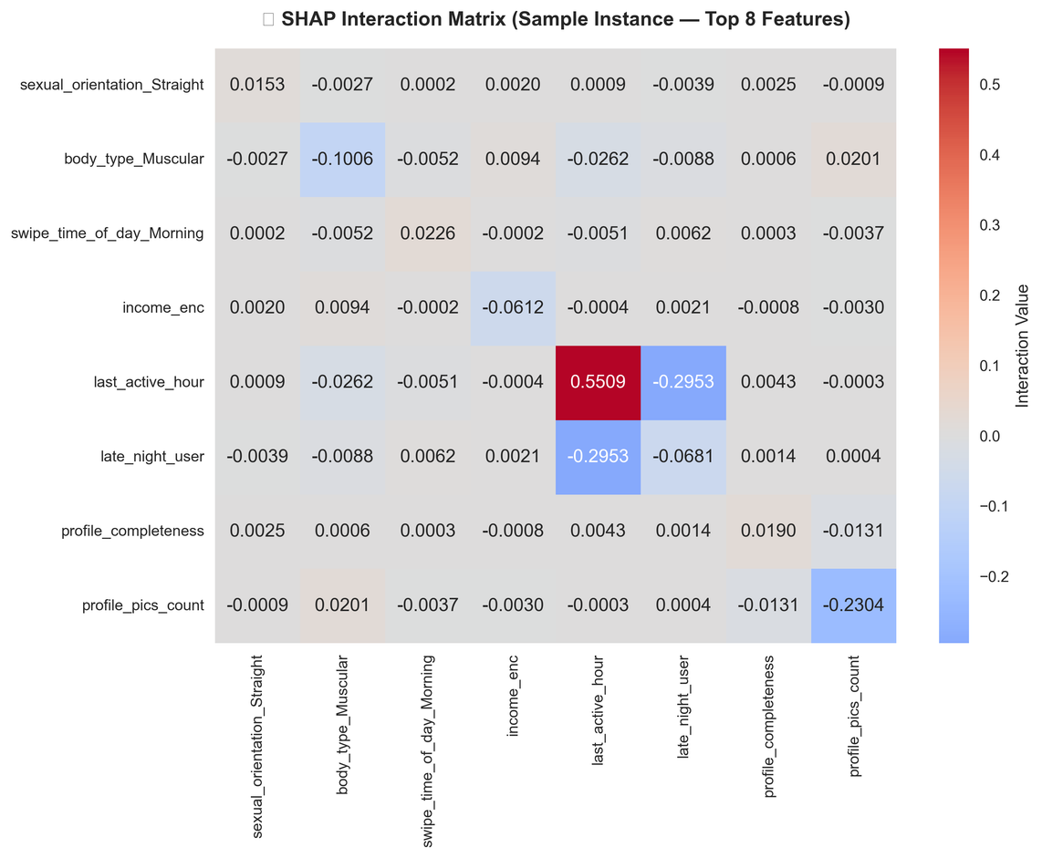
MODEL INTERPRETABILITY WITH SHAP
SHAP explains:
Global feature importance
Individual predictions
Feature impact direction
Benefits:
Transparency
Trustworthiness
Explainability

Slide 18
DOUBLE MACHINE LEARNING (DML)
Beyond prediction, we estimated causal effects.
DML allows us to estimate:
"What happens if a behaviour changes?"
Result:
Average Treatment Effect (ATE)
= 0.0104
Interpretation:
Behavioural interventions produce only a very small improvement in connection probability.
Treatment
DML
Outcome

Slide 19
MAJOR FINDINGS
Sophisticated models failed to significantly outperform baseline.
Most features show overlapping distributions between classes.
ROC-AUC remained near random guessing.
Dataset contains very weak predictive signals.
Relationship outcomes may depend on factors absent from the dataset.

Slide 20
CONCLUSION
Achievements:
✓ Built complete ML pipeline
✓ Evaluated 14 ML models
✓ Applied Explainable AI
✓ Applied Causal Inference
Key Scientific Finding:
Despite extensive modelling, relationship outcomes remain highly unpredictable using the available features.
Future Work:
Real-world dating datasets
Text analysis of conversations
Graph neural networks
Sequential behavioural modelling
@REALLYGREATSITE | WWW.REALLYGREATSITE.COM

